Slide 1
North Korean
IT Worker Fraud
CISO Playbook
October 2025

Slide 2
Executive Summary

Slide 3
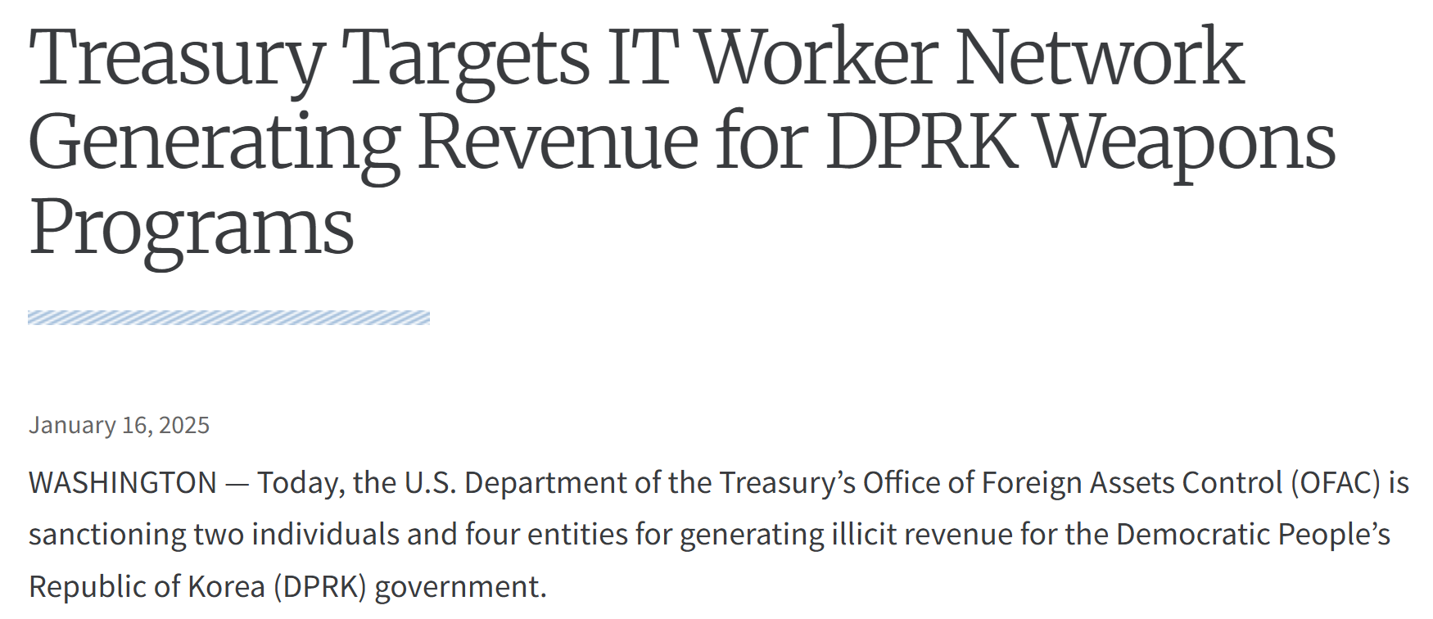
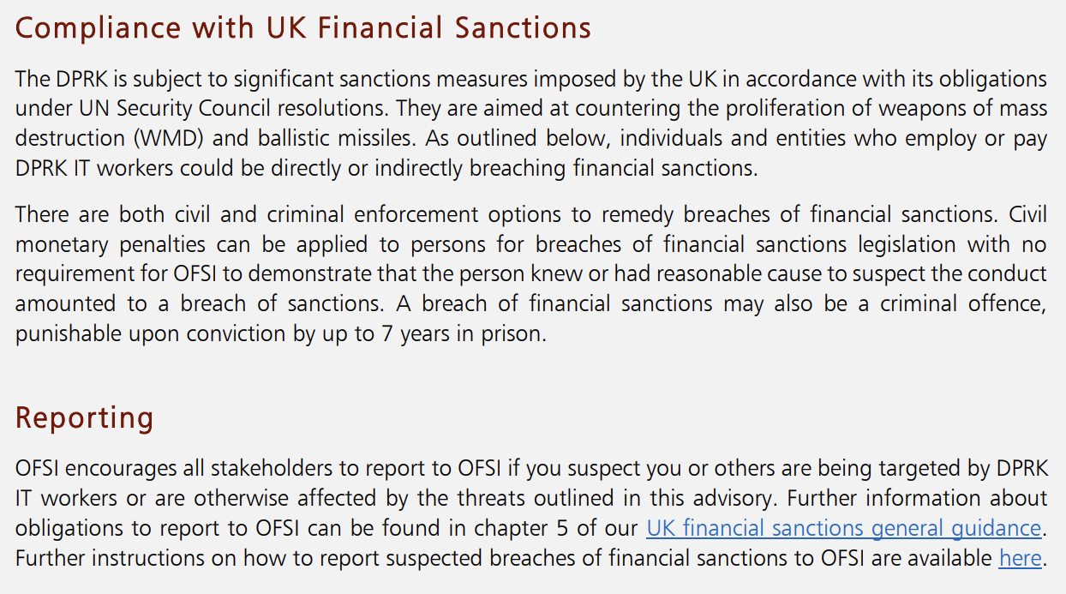
The Risk
DPRK IT Workers present real risk to businesses
North Korea is already a heavily sanctioned country with sanctions in place from the United Nations (UN), UK and U.S. among others.
Additional sanctions placed on individuals and entities involved in this scam.
Western companies hiring these workers expose themselves to penalties for breaching sanctions.
https://home.treasury.gov/news/press-releases/jy2790
https://assets.publishing.service.gov.uk/media/66e2ec410d913026165c3d91/OFSI_Advisory_on_North_Korean_IT_Workers.pdf

Slide 4

Trends in DPRK Fraudulent Applicants
Seeking full stack developer jobs
Portray having ~8–10 years of experience
List ~3–4 prior companies in work history
Often novice to intermediate English-speaking skills
Instances where resumes are clones across several applicants
Lack of continuity in work quality

Slide 5
Fake Hires, Real Threats
You can help stop fake employees by notifying your line manager of the following behaviors:
In 2025, there has been a sharp rise in attempts by nation-state operatives, particularly from North Korea, to infiltrate Western software companies.
These individuals, posing as legal residents, have successfully secured long-term roles in organisations like Sophos by applying for open job vacancies under false identities.
🔍 1. Reluctance to Appear on Camera
  Avoids video calls, even when it's standard team practice
  May use excuses like “camera broken” or “bandwidth issues” repeatedly
🗣️ 2. Inconsistent Communication or Language Ability
  Fluctuates between strong and weak English (or technical fluency)
  Responses may sound overly scripted or AI-generated
🧠 3. Surface-Level Technical Knowledge
  Struggles with hands-on tasks despite an impressive resume
  Frequently defers to others or avoids taking ownership of work

Slide 6
HR Talent Acquisition Checklist

Slide 7
What is a Fraudulent Candidate Scam?
A fraudulent candidate scam occurs when an individual misrepresents their qualifications, skills, or work experience to gain employment. There may be several reasons for joining e.g personal gain or malicious intent.
Common Motives:
Financial Gain
Fake candidates have found ways to earn significant amounts of money. For instance, a group of workers in China remotely accessing corporate laptops located in their area of employment, such as Tennessee.
Access to Sensitive Information
Individuals may gain access to confidential company information, software repos, source code, intellectual property, or data. This could be used to blackmail the company, espionage, selling the information to competitors or destroying brand trust.
Testing the Hiring Process
Candidates may start the hiring process simply to understand the controls. They may have no intention of being hired into the position but use the experience to understand how they can manipulate the system in future applications.

Slide 8
Hiring a fraudulent candidate poses considerable risks, that’s why it's important to have thorough screening processes in place. This should encompass a combination of vetting processes and background checks.
Below are several steps you can take to enhance the hiring process.
Job Application Screening
Look for inconsistencies (name, employment dates, vague job descriptions)
Check for unexplained gaps or excessive job-hopping, especially with no career progression or other notable activities
Verify references, work, and education history. Remote fake candidates my have multiple jobs (even at the same company)
Check for duplicates in the CV/resume database e.g. name, email address, phone number etc. Candidates may have applied to several roles
Compare permanent address with work location history
Compare CV/resume with online profiles (e.g., LinkedIn)
Search online for public mentions of the candidate
Onboarding
Validate candidate’s ID (in person or via secure video)
Cross-check employment references to ensure validity
Monitor for unusual behaviour and reluctancy in completing HR forms or showing hesitancy in providing necessary documentation
Ensure bank account details are legitimate and account name matches candidate. If using a personal bank account, verify with a trusted bank or financial institution. Fake candidates may use virtual bank accounts
Track digital signatures on offer letters and contracts
Monitor for unusual address changes, especially for hardware shipments
Check contractor payment terms, flag if advance payment is requested
By employing these strategies, you can significantly reduce the chances of hiring a fraudulent candidate,
thereby ensuring that your recruitment process is both robust and effective.

Slide 9





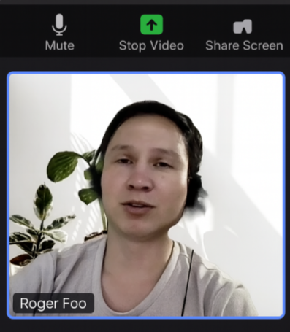
There are several key checks and strategies Talent Acquisition could implement that may significantly reduce the chances of hiring a fake candidate, protecting the organisation from risks such as financial loss, data breaches, and reputational damage.
CVs or resumes that seem too perfect (e.g. inflated job titles, vague descriptions, or obscure past employers)
Inconsistencies between the résumé and online profiles (e.g. LinkedIn)
Vague answers or limited understanding of claimed skills during interviews
Reluctance to use video calls; preference for text-only communication
Language and technical skills does not match CV/Resume
Top Tips
Check for duplicates in the CV/ Resume database
Conduct live video interviews, make note if they refuse, you hear strange background noises or spot anything unusual
Compare with online profiles on multiple platforms (e.g. LinkedIn)
Leverage assessment platforms to evaluate candidate skills, this may help filter fake candidates before they reach the interview stage
Common Red Flags
Confirmed fake applicant
If something feels off, don’t ignore it - body language and communication gaps can reveal a lot.

Slide 10
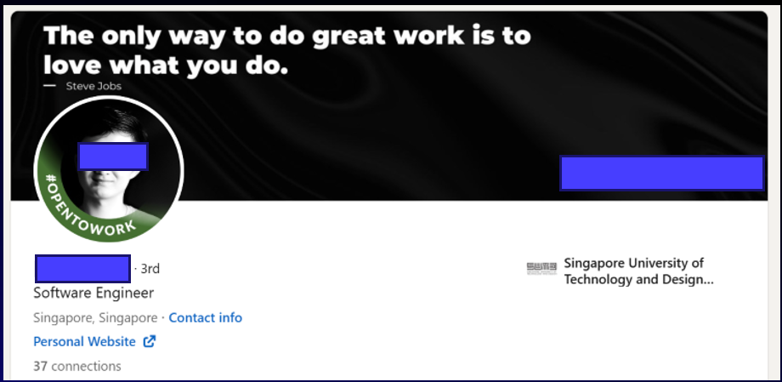
Steps to Verify Candidates
Prior to hiring – reviewing applicant references & job history
The area code for company phone numbers or listed on websites does not match purported locations of company offices
Company addresses in work history map to residential properties rather than office buildings
Aspirational quotes and promotional phrases on profiles or company websites appear disjointed and clumsily written

Slide 11
Steps to Verify Candidates
Post-hire suspicious indicators
Refusal to turn on video during calls or use of face changing filters
Background noise on voice calls indicates employee
is working from a call center style environment
Unjustified concern surrounding in-person meetings
Laptop language preference set to Korean despite claiming to be from a non-Korean speaking country
Requests for prepayment

Slide 12
IT Checklist

Slide 13
IT Checklist
Key Takeaways
Hardware Shipping
Confirm shipping details matches HR new hire records
Track shipments to ensure the hardware is sent to the correct, verified address
User Identification
Restrict account creation until new hires have been properly onboarded through the HR system
Ensure that personal details (name, position, department) align with HR records
Apply minimum access & Role-Based Access Control (RBAC)
System & Network Monitoring
Monitor alerts for unauthorised access or unusual behaviour
Ongoing Collaboration
Regularly sync with HR for pre-employment validation
Collaborate with the Cybersecurity team for monitoring suspicious activities
Exit Procedures & Offboarding
Immediately deactivate accounts upon departure
Monitor post-exit access attempts
Verify: Confirm details with HR before creating accounts or shipping hardware
Access Control: Restrict access and permissions
Monitor: Track new user activity for unusual behaviour and access patterns
Collaboration: Work with HR and the Cybersecurity team to ensure any suspicious activity are flagged immediately

Slide 14
Finance & Payroll Checklist

Slide 15
Payroll Fraudulent Candidate Checklist
This checklist provides a practical guide for Payroll teams to systematically verify new hires and identify potentially fraudulent candidates.
CHECKS | APJ | EMEA | NORAM | RED FLAGS
Identity Verification 1. Match candidate name to ID documents (e.g. government-issued ID/passport) 2. Cross-check ID numbers with national databases (where applicable) | PAN (India) TFN (Aus, NZ) PHIC (Philippines) My Number (Japan) | NIN (UK) EU ID Local equivalent based on country | SSN (USA) SIN (Canada) | Mismatched names or photos Shared IDs across multiple hires Unverifiable ID numbers
Bank Account Verification 1. Validate that the bank account is in the candidate’s name and it matches the employee's country of residence. For bank account changes, always contact the employee via their Sophos email address (as well as Teams, if possible) for confirmation. Do not confirm via employee personal email address | Account must be in candidate's legal name Request a cancelled cheque or official bank letter, where possible | Account must be in candidate's legal name Cross-check IBAN/ SWIFT codes with official banks | Account must be in candidate's legal name Validate ABA routing and account verification | Avoid processing payroll to third-party or joint accounts, unless approved Watch for multiple employees using the same account number
Tax ID Verification 1. Validate Tax ID from official portals. Ensure only one employee is linked to that Tax ID in your system. | PAN (India) TFN (Aus, NZ) PHIC (Philippines) My Number (Japan) | NIN (UK) EU ID Local equivalent based on country | SSN (USA) SIN (Canada) | Duplicate Tax ID in the payroll system or shared tax IDs Fake or unregistered tax numbers

Slide 16
Cybersecurity Checklist

Slide 17
Security Monitoring
It is imperative for organizations to leverage Endpoint Detection and Response (EDR), Network Detection and Response (NDR), and Data Loss Prevention (DLP) tools to discover North Koreans who have taken roles in their organization
Regular monitoring should include:
  Unapproved Remote Monitoring and Management Tools
  Unexpected VPN services, especially from residential VPNs or known-bad VPN services
  Exfiltration of data via unusual paths such as online storage or USB devices
Key Takeaways
Verify: You have an up to date asset inventory
Access Control: Adhere to the principle of least privilege
Monitor: Flag logins from unexpected or high risk geolocations, look for impossible travel
Collaboration: Work with IT and HR to ensure any suspicious activities are flagged and reviewed immediately
Notes:
Sophos: NICKEL TAPESTRY expands fraudulent worker operations
Mandiant: Staying a Step Ahead: Mitigating the DPRK IT Worker Threat
ReliaQuest: Threat Spotlight: Red Flags for Red Star Hackers: Hunting for North Korean Insiders
SentinelOne: DPRK IT Workers | A Network of Active Front Companies and Their Links to China

Slide 18
Threat Hunting
System Accesses from Associated Infra
Lack of Normal Business Engagement (Silent Work)
Internal Data Enumeration
Early wins can be instrumental in building momentum. Conducting threat hunts within the organization and sharing the findings with leadership can demonstrate the tangible risk and justify broader cross-functional engagement.
Potential Data Sources:
GitHub
Office Suite
Identity Providers
XDR
Central Email
EAA
Akamai
Activity Directory
Investigate failed AD logins using unrecognized domains to identify OPSEC lapses where North Korean actors reused credentials across environments.
Profiled new hires with minimal engagement in collaboration tools (Teams, Slack, Outlook) and access to expected systems.
Analyse OneDrive and SharePoint downloads by recent hires to detect unusual access to sensitive documents and investigation materials.
Use of Activity
Spoofing Tools
Career
Submissions
Anomalous Code Repository Accesses
Identify endpoints with constant uptime but low process activity, revealing use of mouse jiggler software.
Review access to your Careers pages from low-reputation ASNs and rare geographies to infer potential North Korean job applications.
Review users cloning many GitHub repos with few commits, especially outside their team scope.
Notes:
Sophos: NICKEL TAPESTRY expands fraudulent worker operations
Mandiant: Staying a Step Ahead: Mitigating the DPRK IT Worker Threat
ReliaQuest: Threat Spotlight: Red Flags for Red Star Hackers: Hunting for North Korean Insiders
SentinelOne: DPRK IT Workers | A Network of Active Front Companies and Their Links to China

Slide 19
Case Studies

Slide 20

Lessons from a Recruiting Agency
Initial lead: company-owned laptop discovered in laptop farm
Characteristics
DPRK candidates will act as references for each other
Resumes are sometimes clones of each other
Multiple candidates use the same phone number
Use stolen identities

Slide 21
Lessons from a Recruiting Agency
…continued
Hired Instances
Last minute change of address when laptops are shipped
Changes to payment info last minute
Consultants are often flagged for poor performance at 6 to 8 week mark
In cases where consultants last ~1 year, leverage
this as a reference for future employment
Scheme traced back to at least 2019, DPRK
candidates are less careful/meticulous over time

