Slide 1
Cysurance Program for Sophos MDR Customers in the U.S.
Cysurance Certification Warranty
and Cyber Insurance Programs
| Partner Program Overview | October 2024

Slide 2
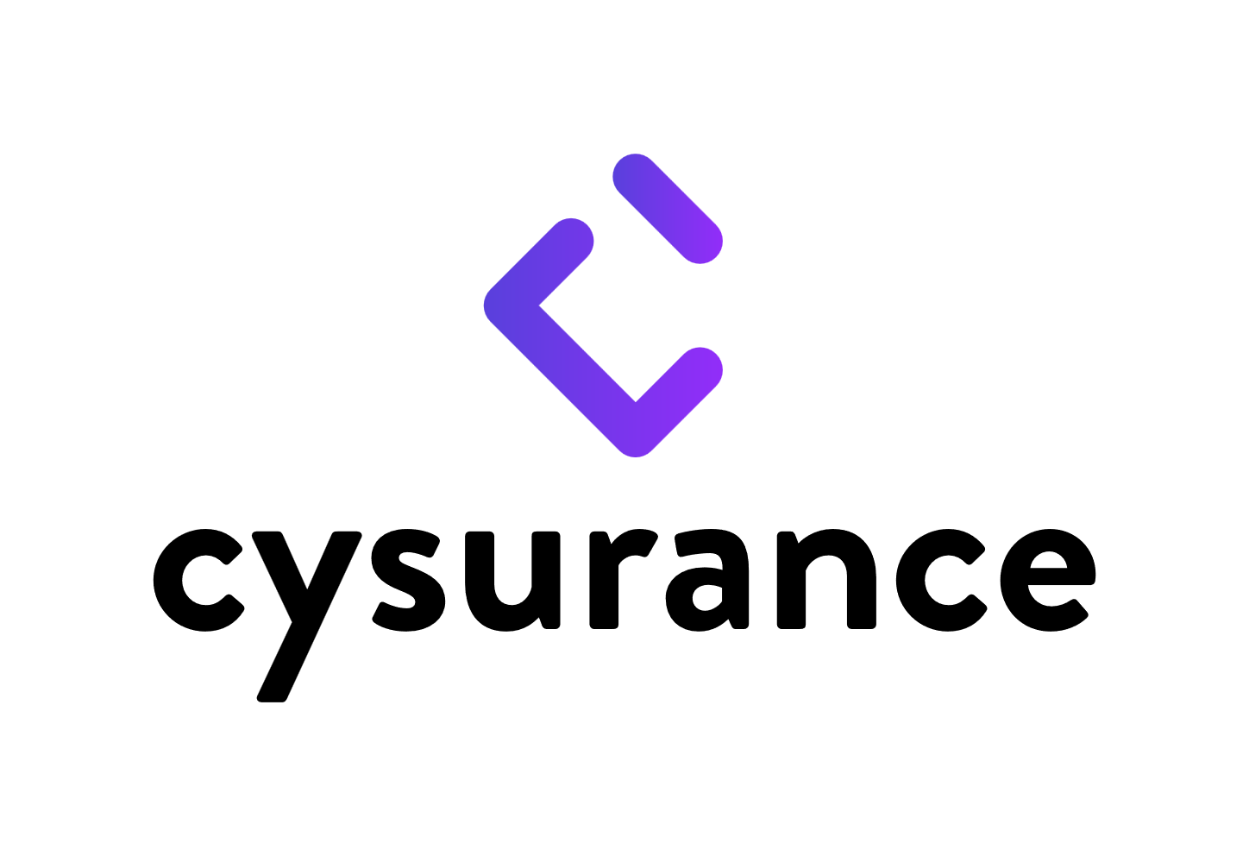
Exclusive Plans for Sophos MDR Customers
Sophos MDR users with up to $100M annual revenue and that have Cysurance’s requisite security controls in place automatically qualify for the Cysurance Certification and Certified Cyber Insurance programs.
Certified Cyber Insurance Endorsements
Program Highlights
First Party Expense
Business Interruption (First Party)
Business Email Compromise (BEC)
Digital Asset Destruction
Reputational Income Loss
Cyber Extortion
Incident Response Expenses
Funds Loss
Third Party Expense
Security and Privacy Liability
Regulatory Defense and Penalties
Multimedia Liability
PCI Fines and Expenses
Fixed price plans that provide up to $3.2M coverage - see the cost up-front
Includes BEC and Business Interruption/ Contingent Business Interruption coverage
Sophos MDR users qualify automatically
Custom pricing available for organizations with up to $4B annual revenue
Up to $5M total coverage available
Learn more, get personalized quote and apply: https://enroll.cysurance.com/sophos
Insurance offered by Cysurance, LLC. NY License 1578397, Insurance provided by DUAL and its U.S. based underwriting company affiliates. All products may not be available in all states. This communication contains product summaries only. Coverage is subject to the language of the policies as actually issued. Nothing herein should be construed as involving the sale, solicitation or negotiation of insurance or the provision or offer of insurance services.
Please note that Sophos is not a licensed insurance producer and does not sell, solicit or negotiate insurance products. All insurance-related information is provided by Sophos’ licensed partners and does not in any way alter or amend the terms, conditions, or exclusions of any insurance policy. By providing access to any third-party websites, Sophos is not recommending or endorsing any such third parties, or any products or services offered by such third parties. To the extent you access a third-party website from a Sophos website, please be advised that Sophos does not investigate, monitor, or check any third-party websites, or the content of such websites, for accuracy, appropriateness, or completeness, and you are solely responsible for your interactions with such third parties.

Slide 3
Exclusive Plans for Sophos MDR Customers with less than $50M Revenue
$275,000
Total Coverage
$550,000
Total Coverage
$1,150,000
Total Coverage
$2,150,000
Total Coverage
$3,200,000
Total Coverage
$250,000 Cyber Policy
+
$25,000 additional ransomware coverage
$500,000 Cyber Policy
+
$50,000 additional ransomware coverage
$1,000,000 Cyber Policy
+
$150,000 additional ransomware coverage
$2,000,000 Cyber Policy
+
$150,000 additional ransomware coverage
$3,000,000 Cyber Policy
+
$200,000 additional ransomware coverage
$900
Total Cost
$1,150
Total Cost
$2,400
Total Cost
$3,600
Total Cost
$4,650
Total Cost
$650 Premium
$100 Policy fee
$150 Cysurance certification
$850 Premium
$100 Policy fee
$200 Cysurance certification
$1,750 Premium
$100 Policy fee
$550 Cysurance certification
$2,950 Premium
$100 Policy fee
$550 Cysurance certification
$3,950 Premium
$100 Policy fee
$600 Cysurance certification
$5,000
Retention
$5,000
Retention
$10,000
Retention
$10,000
Retention
$10,000
Retention
Pricing shown reflects typical premiums available to most customers. Some exceptions may apply. Customized quoting available for organizations that require up to $5M coverage and those with $100M - $4B revenue. Contact Cysurance to learn more.
Please note that Sophos is not a licensed insurance producer and does not sell, solicit or negotiate insurance products. All insurance-related information is provided by Sophos’ licensed partners and does not in any way alter or amend the terms, conditions, or exclusions of any insurance policy. By providing access to any third-party websites, Sophos is not recommending or endorsing any such third parties, or any products or services offered by such third parties. To the extent you access a third-party website from a Sophos website, please be advised that Sophos does not investigate, monitor, or check any third-party websites, or the content of such websites, for accuracy, appropriateness, or completeness, and you are solely responsible for your interactions with such third parties.

Slide 4
Exclusive Plans for Sophos MDR Customers with $50M-$100M Revenue
$1,150,000
Total Coverage
$2,150,000
Total Coverage
$3,200,000
Total Coverage
$1,000,000 Cyber Policy
+
$150,000 additional ransomware coverage
$2,000,000 Cyber Policy
+
$150,000 additional ransomware coverage
$3,000,000 Cyber Policy
+
$200,000 additional ransomware coverage
$3,400
Total Cost
$4,650
Total Cost
$5,800
Total Cost
$2,750 Premium
$100 Policy fee
$550 Cysurance certification
$4,000 Premium
$100 Policy fee
$550 Cysurance certification
$5,000 Premium
$200 Policy fee
$600 Cysurance certification
$10,000
Retention
$10,000
Retention
$10,000
Retention
Pricing shown reflects typical premiums available to most customers. Some exceptions may apply. Customized quoting available for organizations that require up to $5M coverage and those with $100M - $4B revenue. Contact Cysurance to learn more.
Please note that Sophos is not a licensed insurance producer and does not sell, solicit or negotiate insurance products. All insurance-related information is provided by Sophos’ licensed partners and does not in any way alter or amend the terms, conditions, or exclusions of any insurance policy. By providing access to any third-party websites, Sophos is not recommending or endorsing any such third parties, or any products or services offered by such third parties. To the extent you access a third-party website from a Sophos website, please be advised that Sophos does not investigate, monitor, or check any third-party websites, or the content of such websites, for accuracy, appropriateness, or completeness, and you are solely responsible for your interactions with such third parties.

Slide 5
Automatic Qualification with Sophos MDR
Organizations using the Sophos MDR service that have Cysurance’s requisite security controls in place automatically qualify for the Cysurance Certification and Certified Cyber Insurance programs, providing two layers of protection against incident remediation and recovery expenses.
Program Benefits
Cysurance Certified Insurance program: Provides up to $5 million in cyber insurance coverage, including full limits, first and third-party expenses, business continuity and disaster recovery plans.
Cysurance Certification program: Reimburses up to $200,000 in remediation and recovery expenses in the event of a ransomware incident, inclusive of breach notification costs, compliance and regulatory penalties, and business income loss.
Program Activation
In the event of a ransomware incident, the Certification program is activated first. Once exhausted, the Certified Cyber Insurance responds to cover additional remediation expenses.
In the event of non-ransomware and business continuity events, the Certified Cyber Insurance responds immediately.
Certification Program
Ransomware
Compliance
Business Income Loss
Certification Cyber Insurance
Full Coverage
First and Third-Party Expenses
Insurance offered by Cysurance, LLC. NY License 1578397, Insurance provided by DUAL and its U.S. based underwriting company affiliates. All products may not be available in all states. This communication contains product summaries only. Coverage is subject to the language of the policies as actually issued. Nothing herein should be construed as involving the sale, solicitation or negotiation of insurance or the provision or offer of insurance services.

Slide 6
Requisite Security Controls
For the certification warranty to be valid, the following cyber and business control conditions apply:
gaining access to a network via a stolen password and, in doing so, allows other security tools to function as designed.
Customer performs commercially reasonable maintenance, including applying patches and updates within 60 days of release.
As best practice, it is important that the customer follows a patching cadence with commercially reasonable measures taken close to the latest patch cycle release.
The customer applies best efforts towards data privacy and is compliant with any required regulatory conditions.
If applicable, customer must adhere to any national, state, federal, and/or regulatory,
privacy and security policies related to which they are subject, including, but not limited to PCI, HIPAA, GDPR and SEC standards.
For subscribers regulated under HIPAA/PCI/ SEC/OSHA:
An annual risk assessment is completed and documented.
PHI was inventoried and accounted for prior to the incident.
All employees completed HIPAA training prior to the incident and within the past 12 months.
All events must be verified through log data
The warranty will not respond to a systemic failure of service provider infrastructure and/ or an application, or software that results in a loss for your customer.
Customer deploys industry standard and up-to-date anti-virus or comparable prevention tools on its endpoints.
In the event of a claim for reimbursement the affected endpoint(s) log data will be required to validate the claim.
PHI encryption (only if HIPAA regulated) and/or data back-ups are in place.
A cyber breach can often be resolved quickly through back-up restoration. A back-up solution that encrypts data at rest and is regularly scanned for viruses and malicious data is required. Cloud back-up solutions are also acceptable if they meet these criteria.
Certified Cyber Insurance includes:
Full Limits
First and Third-Party Expense
Business Continuity & Disaster Recovery Plans
Business Email Compromise (BEC)
The customer must offer security awareness training to their employees.
All employees should receive security awareness training to ensure they have the skills required to identify an attack.
Out-of-cycle wire transfers and invoice routing information changes must be verified with the requestor and documented.
Business controls that document any change request to invoice routing and wire transfers is required and documentation provided in the event of an attack.
Multi-factor authentication active on all customer email accounts.
Multi-factor authentication is important, as it makes the stealing of information harder for the average criminal. MFA prevents bad actors from
Insurance offered by Cysurance, LLC. NY License 1578397, Insurance provided by DUAL and its U.S. based underwriting company affiliates. All products may not be available in all states. This communication contains product summaries only. Coverage is subject to the language of the policies as actually issued. Nothing herein should be construed as involving the sale, solicitation or negotiation of insurance or the provision or offer of insurance services.

Slide 7
Certified Cyber Insurance
Cysurance Certified Cyber Insurance offers full coverage limits; incident response costs are covered up to the policy's total limit. The policy also includes special endorsements that cover bricking of devices and betterment enhancements, which allows for upgrading hardware and systems to current-day standards following a breach.
Certified Cyber Insurance Features
Cyber Insurance Coverage up to $5M
Full Coverage Limits
First and Third-Party Expense
Certified Cyber Insurance Endorsements
First Party Expense - Insuring Agreements | Cover
Business Interruption (First Party) Business Email Compromise (BEC) | Aggregate Limit $250,000
Digital Asset Destruction | Aggregate Limit
Reputational Income Loss | Aggregate Limit
Cyber Extortion | Aggregate Limit
Incident Response Expenses | Aggregate Limit
Third Party Expense - Insuring Agreements | Cover
Security and Privacy Liability | Aggregate Limit
Regulatory Defense and Penalties | Aggregate Limit
Multimedia Liability | Aggregate Limit
Payment Card Industry Fines and Expenses | Aggregate Limit
Certified Cyber Insurance includes:
Full Limits
First and Third-Party Expense
Business Continuity & Disaster Recovery Plans
Business Email Compromise (BEC)
Controls Required for Activation
Sophos MDR Active Subscription
Cysurance Certification Conditions
MFA on all email accounts
Back-ups (scanned for viruses)
PHI/PII encryption (if regulatory conditions apply)
Data privacy compliance (if regulatory conditions apply)
Patch updates within 60 days of release
All events verified through log data
Insurance offered by Cysurance, LLC. NY License 1578397, Insurance provided by DUAL and its U.S. based underwriting company affiliates. All products may not be available in all states. This communication contains product summaries only. Coverage is subject to the language of the policies as actually issued. Nothing herein should be construed as involving the sale, solicitation or negotiation of insurance or the provision or offer of insurance services.

Slide 8
FOR MORE INFORMATION
SOPHOS@CYSURANCE.COM | 917 – 503 – 8031
Follow us :
linkedIn.com/company/cysurance
facebook.com/cysurance
twitter.com/cysurance
https://enroll.cysurance.com/sophos
Copyright © Cysurance, LLC. All Rights Reserved.

