Slide 1
Cysurance Program for Sophos MSPs
Cysurance Certification Warranty
and Cyber Insurance Programs
| Partner Program Overview | October 2024

Slide 2
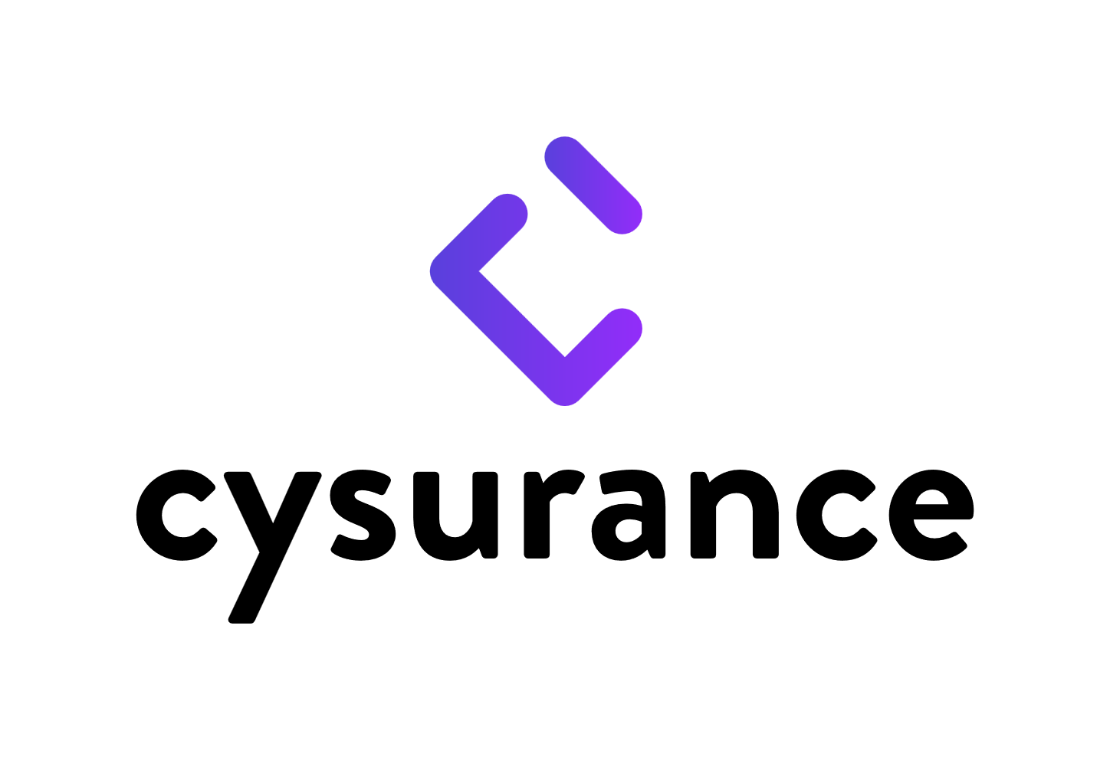
Exclusive Insurance Plan for Sophos MSPs
MSPs with up to $25M annual revenue using the Sophos MDR service and that have Cysurance’s requisite security controls in place automatically qualify for the Cysurance Certification and Certified Cyber Insurance programs.
First Party Expense
Business Interruption
Business Email Compromise (BEC)
Digital Asset Destruction
Reputational Income Loss
Cyber Extortion
Incident Response Expenses
Funds Loss (Social Engineering)
Third Party Expense
Contingent Business Interruption
Security and Privacy Liability
Regulatory Defense and Penalties
Multimedia Liability
PCI Fines and Expenses
Controls required for activation:
Sophos MDR Active Subscription
MFA on Email
Privilege Access Management (PAM) for Multifactor Authentication (MFA) for Essential Services/Cloud Environments
Documented Onboarding/Offboarding Credential Management
Patch updates within 60 days of release
Backups
PII/PHI Encryption when applicable
All events verified through log data
Learn more and apply: https://enroll.cysurance.com/sophos
Request a personalized quote at: sophos@cysurance.com
Insurance offered by Cysurance, LLC. Delaware License 3000712359. All products may not be available in all states. This communication contains product summaries only. Coverage is subject to the language of the policies as actually issued.
Please note that Sophos is not a licensed insurance producer and does not sell, solicit or negotiate insurance products. All insurance-related information is provided by Sophos’ licensed partners and does not in any way alter or amend the terms, conditions, or exclusions of any insurance policy. By providing access to any third-party websites, Sophos is not recommending or endorsing any such third parties, or any products or services offered by such third parties. To the extent you access a third-party website from a Sophos website, please be advised that Sophos does not investigate, monitor, or check any third-party websites, or the content of such websites, for accuracy, appropriateness, or completeness, and you are solely responsible for your interactions with such third parties.
Notes:
TechEO = Technology Errors and Omissions insurance
It is designed to protect your business against claims related to errors or oversights in the design, development, and/or delivery of your technology products and services.
This type of coverage can help safeguard your company from costly lawsuits that could arise if a customer suffers financial losses due to an error made by your company.

Slide 3
$1.5M Coverage Plans for Sophos MSPs using Sophos MDR
$1,500,000 Coverage
$1,000,000 Cyber Policy + $500,000 Cysurance certification warranty
<$5M
Annual Revenue
$5M-$10M Annual Revenue
$10M-$15M Annual Revenue
$15M-$20M Annual Revenue
$20M-$25M Annual Revenue
$5,650
Total Cost
$8,450
Total Cost
$11,250
Total Cost
$13,750
Total Cost
$16,250
Total Cost
$4,700 Premium
$200 Policy fees
$750 Cysurance certification
$7,500 Premium
$200 Policy fees
$750 Cysurance certification
$10,000 Premium
$500 Policy fee
$750 Cysurance certification
$12,500 Premium
$500 Policy fee
$750 Cysurance certification
$15,000 Premium
$500 Policy fee
$750 Cysurance certification
$10,000
Retention
$10,000
Retention
$10,000
Retention
$10,000
Retention
$10,000
Retention
Pricing shown reflects typical premiums available to most Sophos MSPs. Some exceptions may apply. Contact Cysurance to learn more.
Please note that Sophos is not a licensed insurance producer and does not sell, solicit or negotiate insurance products. All insurance-related information is provided by Sophos’ licensed partners and does not in any way alter or amend the terms, conditions, or exclusions of any insurance policy. By providing access to any third-party websites, Sophos is not recommending or endorsing any such third parties, or any products or services offered by such third parties. To the extent you access a third-party website from a Sophos website, please be advised that Sophos does not investigate, monitor, or check any third-party websites, or the content of such websites, for accuracy, appropriateness, or completeness, and you are solely responsible for your interactions with such third parties.

Slide 4
$2.5M Coverage Plans for Sophos MSPs using Sophos MDR
$2,500,000 Coverage
$2,000,000 Cyber Policy + $500,000 Cysurance certification warranty
<$5M
Annual Revenue
$5M-$10M Annual Revenue
$10M-$15M Annual Revenue
$15M-$20M Annual Revenue
$20M-$25M Annual Revenue
$8,600
Total Cost
$13,550
Total Cost
$17,750
Total Cost
$21,000
Total Cost
$26,250
Total Cost
$7,650 Premium
$200 Policy fees
$750 Cysurance certification
$12,300 Premium
$500 Policy fees
$750 Cysurance certification
$16,500 Premium
$500 Policy fees
$750 Cysurance certification
$19,750 Premium
$500 Policy fees
$750 Cysurance certification
$25,000 Premium
$500 Policy fees
$750 Cysurance certification
$10,000
Retention
$10,000
Retention
$10,000
Retention
$10,000
Retention
$10,000
Retention
Pricing shown reflects typical premiums available to most Sophos MSPs. Some exceptions may apply. Contact Cysurance to learn more.
Please note that Sophos is not a licensed insurance producer and does not sell, solicit or negotiate insurance products. All insurance-related information is provided by Sophos’ licensed partners and does not in any way alter or amend the terms, conditions, or exclusions of any insurance policy. By providing access to any third-party websites, Sophos is not recommending or endorsing any such third parties, or any products or services offered by such third parties. To the extent you access a third-party website from a Sophos website, please be advised that Sophos does not investigate, monitor, or check any third-party websites, or the content of such websites, for accuracy, appropriateness, or completeness, and you are solely responsible for your interactions with such third parties.

Slide 5
Automatic Qualification with Sophos MDR
Sophos MSPs using the Sophos MDR service that have Cysurance’s requisite security controls in place automatically qualify for the Cysurance Certification and Certified Cyber Insurance programs, providing two layers of protection against incident remediation and recovery expenses.
Program Benefits
Cysurance Certified Insurance program: Provides up to $2 million in cyber insurance coverage, including full limits, first and third-party expenses, business continuity and disaster recovery plans.
Cysurance Certification warranty: Reimburses up to $500,000 in remediation and recovery expenses in the event of a ransomware incident, inclusive of breach notification costs, compliance and regulatory penalties, and business income loss.
Program Activation
In the event of a ransomware incident, the Certification warranty is activated first. Once exhausted, the Certified Cyber Insurance responds to cover additional remediation expenses.
In the event of non-ransomware and business continuity events, the Certified Cyber Insurance responds immediately.
Certification Program
Ransomware
Compliance
Business Income Loss
Certification Cyber Insurance
Full Coverage
First and Third-Party Expenses
Insurance offered by Cysurance, LLC. Delaware License 3000712359. All products may not be available in all states. This communication contains product summaries only. Coverage is subject to the language of the policies as actually issued.

Slide 6
Certified Cyber Insurance
Cysurance Certified Cyber Insurance offers full coverage limits; incident response costs are covered up to the policy's total limit. The policy also includes special endorsements that cover bricking of devices and betterment enhancements, which allows for upgrading hardware and systems to current-day standards following a breach.
Certified Cyber Insurance Features
Full Coverage Limits
First and Third-Party Expense
Certified Cyber Insurance Endorsements
First Party Expense - Insuring Agreements | Cover
Business Interruption (First Party) Business Email Compromise (BEC) | $1,000,000 $250,000
Digital Asset Destruction | $1,000,000
Reputational Income Loss | $1,000,000
Cyber Extortion | $1,000,000
Incident Response Expenses | $1,000,000
Funds Loss (Social Engineering) | $250,000
Third Party Expense - Insuring Agreements | Cover
Contingent Business Interruption | $1,000,000
Security and Privacy Liability | $1,000,000
Regulatory Defense and Penalties | $1,000,000
Multimedia Liability | $1,000,000
Payment Card Industry Fines and Expenses | $1,000,000
Certified Cyber Insurance includes:
Full Limits
First and Third-Party Expense
Business Continuity & Disaster Recovery Plans
Business Email Compromise
Controls Required for Activation
Sophos MDR Active Subscription
Cysurance Certification Conditions
MFA on all Email Accounts
Privilege Access Management (PAM) for Multifactor Authentication (MFA) for Essential Services/Cloud Environments
Documented Onboarding/Offboarding Credential Management
Backups (scanned for viruses)
PII/PHI Encryption (if regulatory conditions apply)
Data privacy compliance (if regulatory conditions apply)
Patch updates within 60 days of release
All events verified through log data
Insurance offered by Cysurance, LLC. Delaware License 3000712359. All products may not be available in all states. This communication contains product summaries only. Coverage is subject to the language of the policies as actually issued.

Slide 7
FOR MORE INFORMATION
SOPHOS@CYSURANCE.COM | 917 – 503 – 8031
Follow us :
linkedIn.com/company/cysurance
facebook.com/cysurance
twitter.com/cysurance
https://enroll.cysurance.com/sophos
Copyright © Cysurance, LLC. All Rights Reserved.

